Slide 1
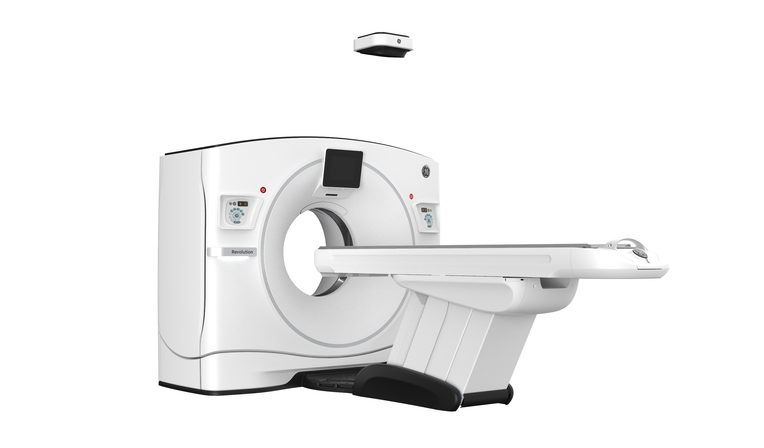
Revolution Frontier Gen 3
Top 10 clinical cases
Revolution Frontier Gen3

Slide 2
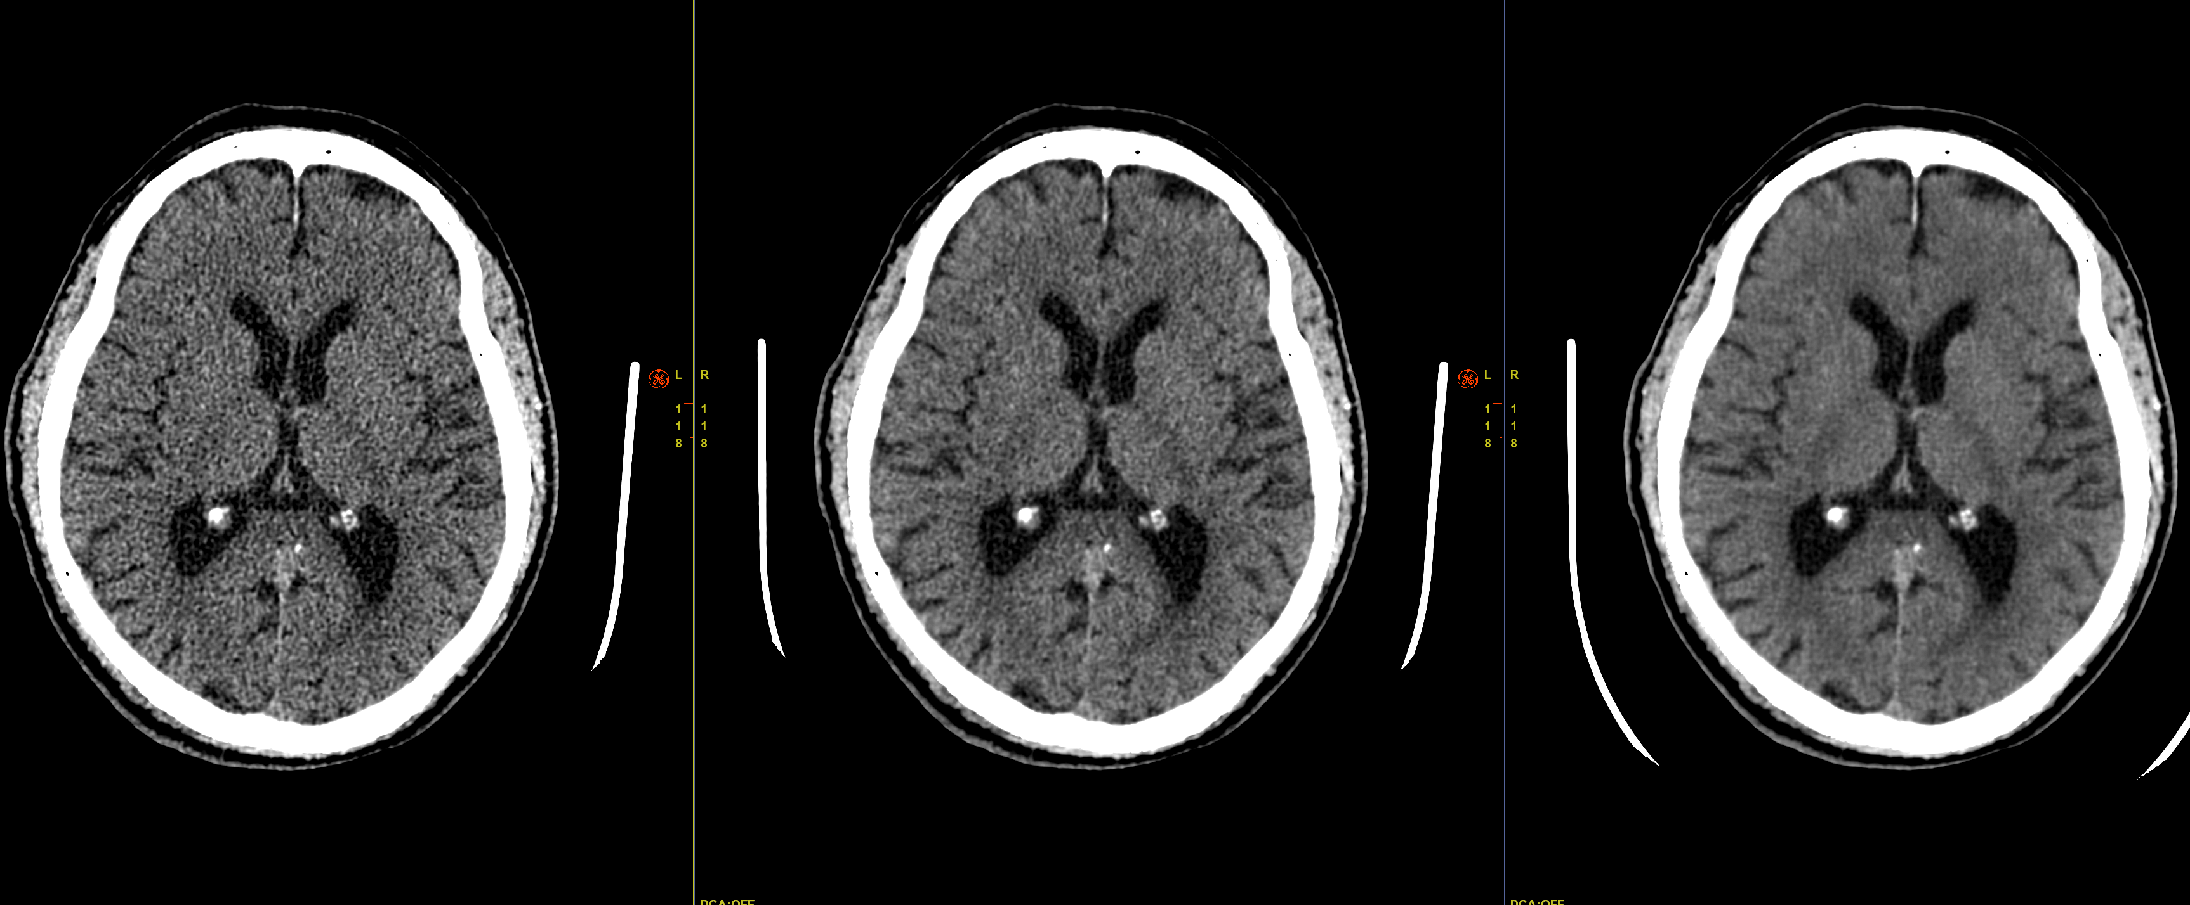
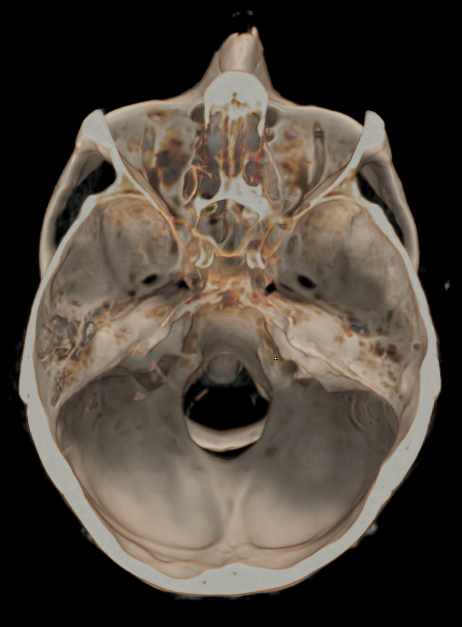
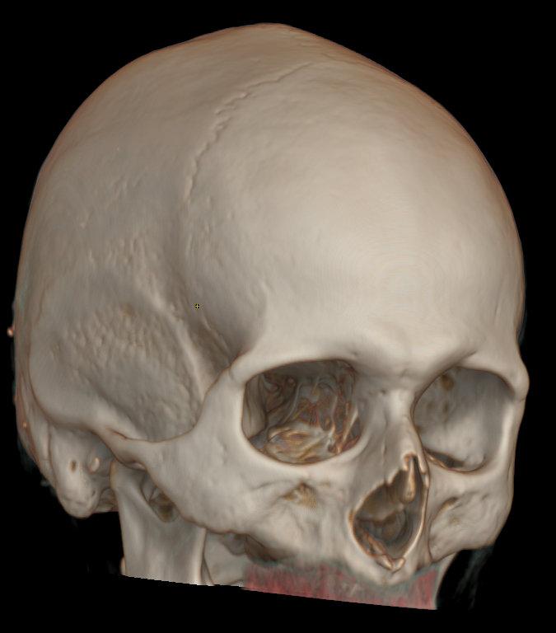

Head scan for trauma with TrueFidelity¹
Scan type | Helical
Rotation time, s | 0,7
Pitch | 0.532
Slice, mm | 1,25
Reconstruction | TF, AV50, FBP
Algorithm | Standard
kV | 120
mA | Mod
Noise index | 3
BMI | 29
CTDIvol, mGy | 39,44
DLP, mGy-cm | 755
FBP
ASIR-V 50
TrueFidelity
History: | Patient fel from a ladder
Findings: | No sign of hematoma or other disease linked to the trauma
Volume illumination TrueFidelity
of CIO (Groupe 3R), Onex, Switzerland.
1. Not commercially available for all regions
Notes:
FTR Gen3 Brain –C ctdi 39 comp FBP vs AR vs TF

Slide 3
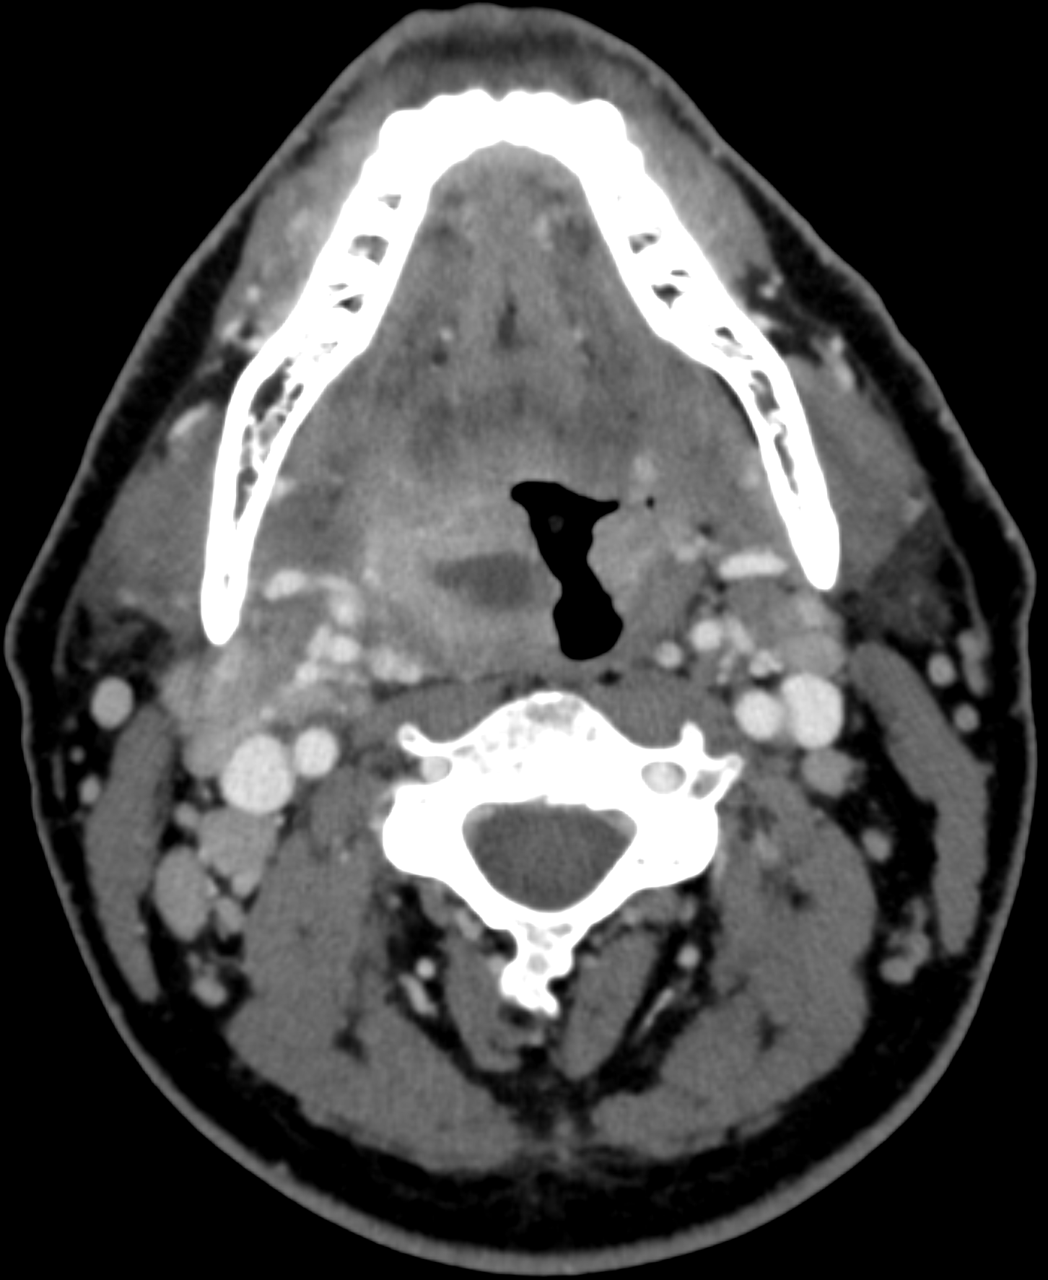

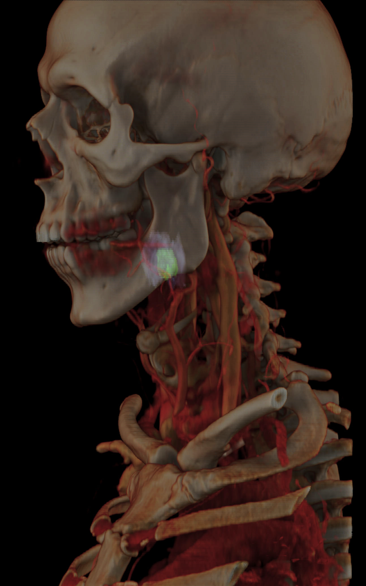
ENT scan with TrueFidelity¹
Scan type | Helical 20 mm
Rotation time, s | 0.6
Pitch | 0.531:1
Slice, mm | 0,625
Reconstruction | DL-H
Algorithm | Standard
kV | 120
mA | Mod
CTDIvol, mGy | 21
DLP, mGy-cm | 670
ASIR-V
Volume Illumination TrueFidelity
ASIR-V
TrueFidelity
1. Not commercially available for all regions
SAINT JOSEPH HOSPITAL – PARIS, DR. ZINS - FRANCE
Notes:
FTR Gen3 Neck ENT ctdi 21 AR vs TF

Slide 4
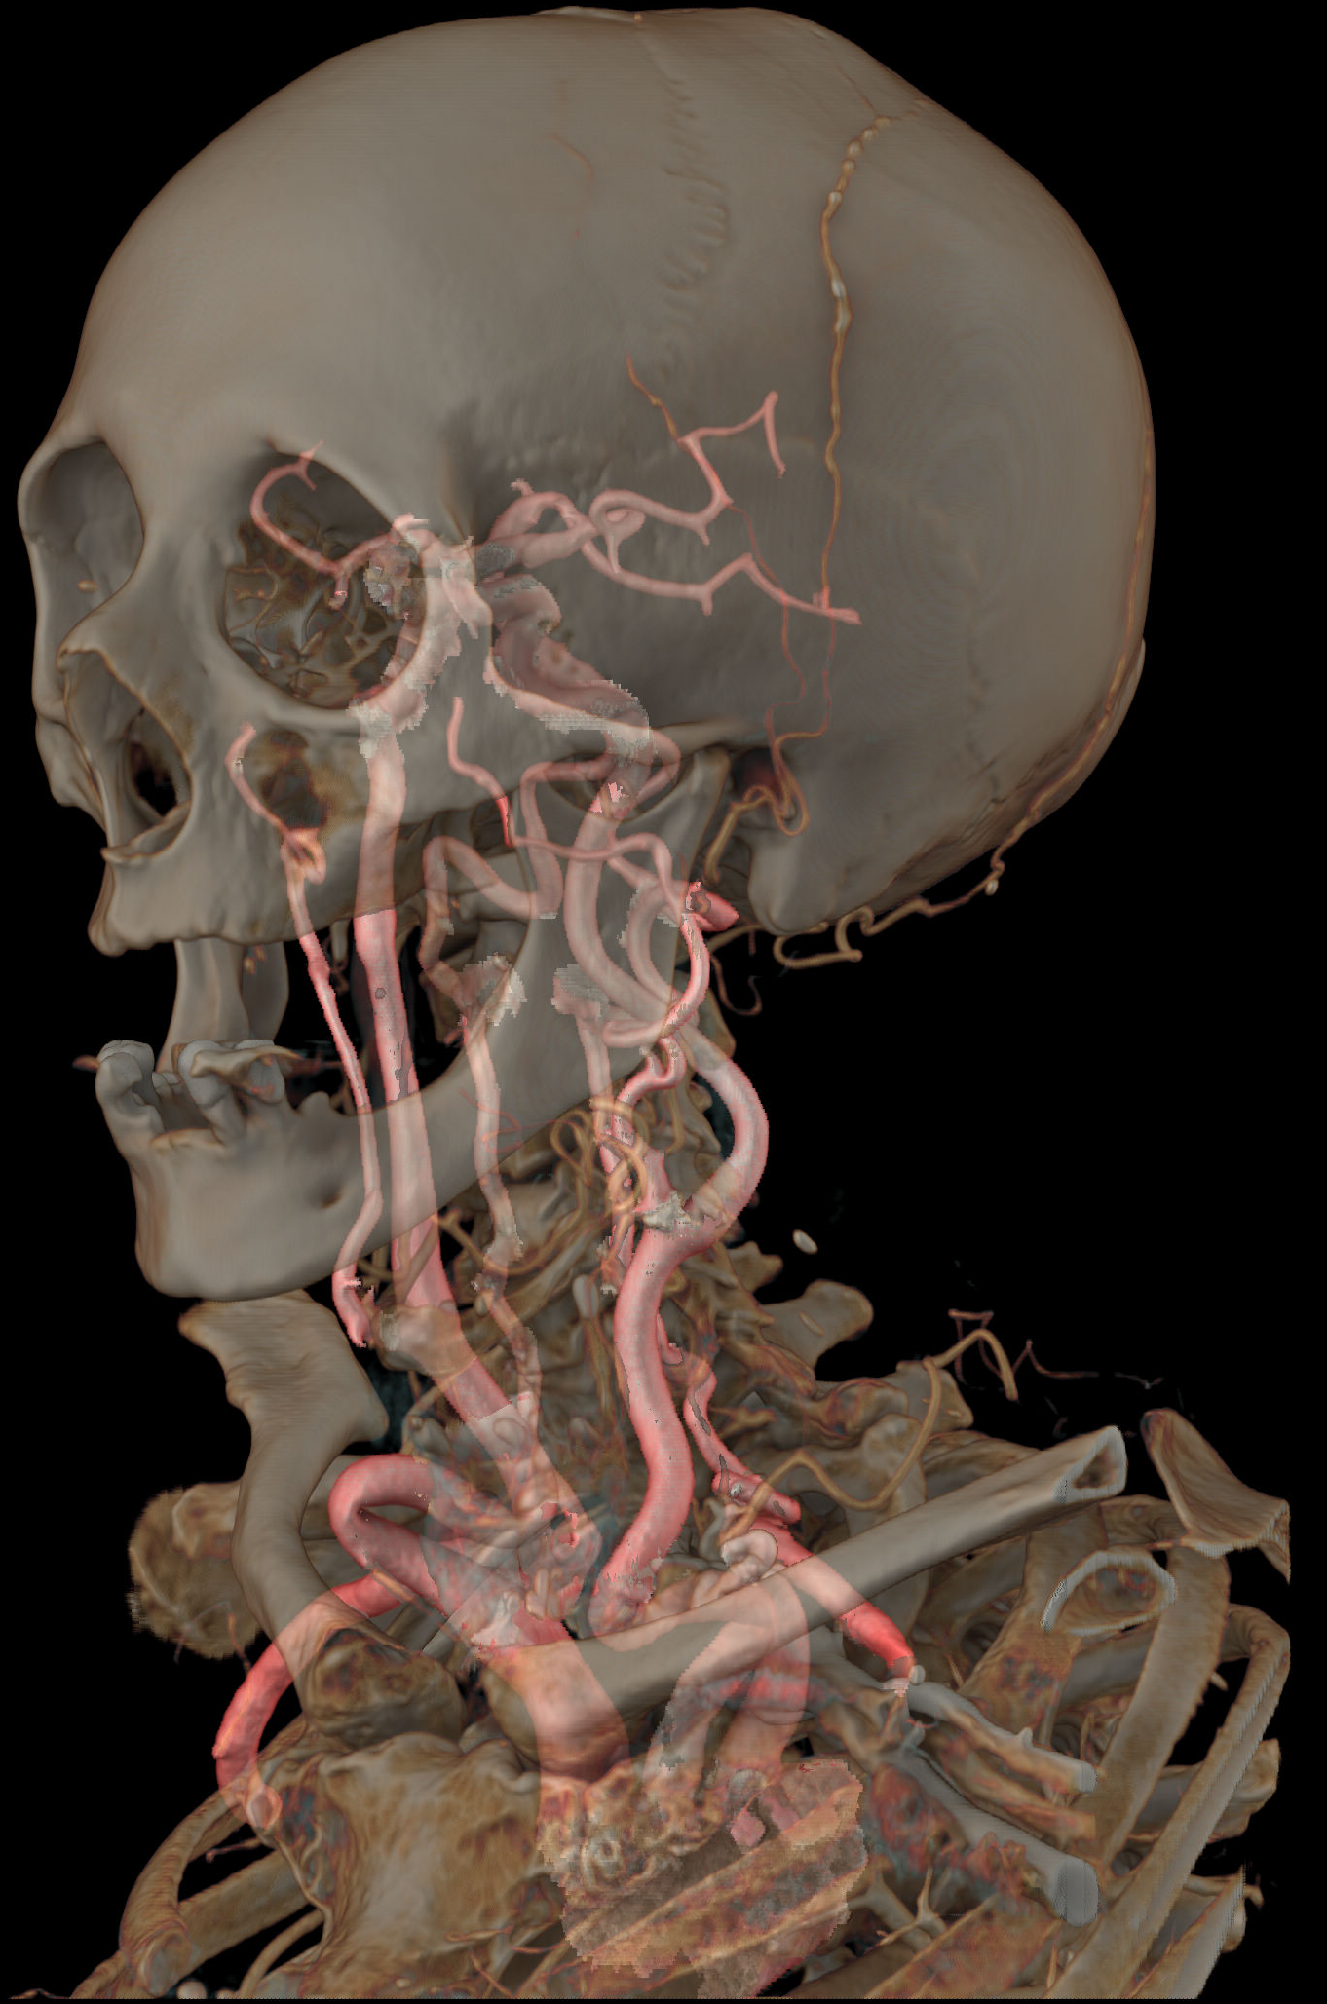
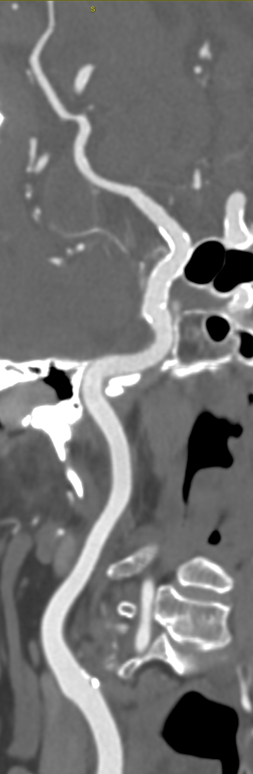
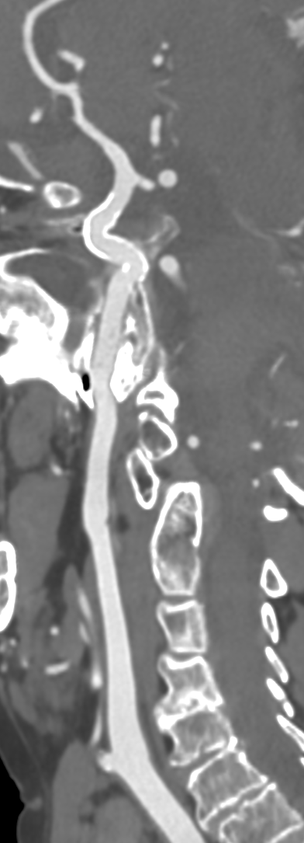
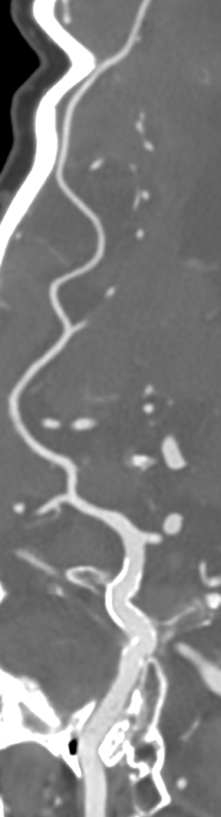
CTA carotids with TrueFidelity¹
Scan type | Helical 40mm
Rotation time, s | 0.35
Pitch | 0.984:1
Slice, mm | 0.625
Reconstruction | DL-H
Algorithm | Standard
kV | 120
mA | Mod.
Noise index
CTDIvol, mGy | 11
DLP, mGy-cm | 330
Volume Illumination TrueFidelity
Curved TrueFidelity
SAINT JOSEPH HOSPITAL – PARIS, DR. ZINS - FRANCE
1. Not commercially available for all regions
Notes:
FTR Gen3 CTA Carotids 1024 AR vs TF CTDI 11

Slide 5
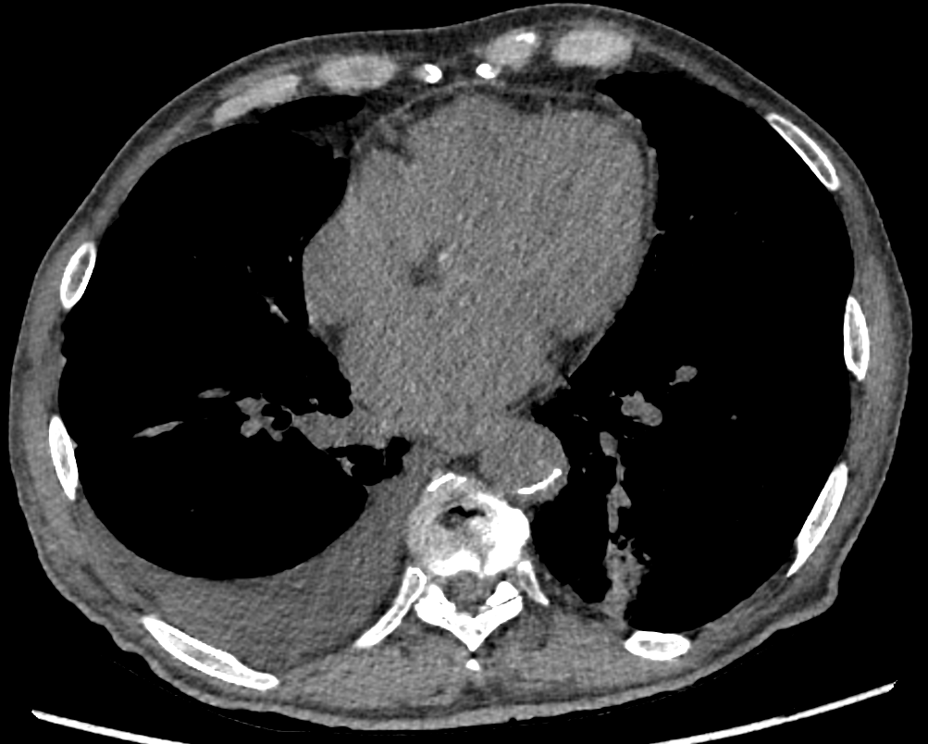
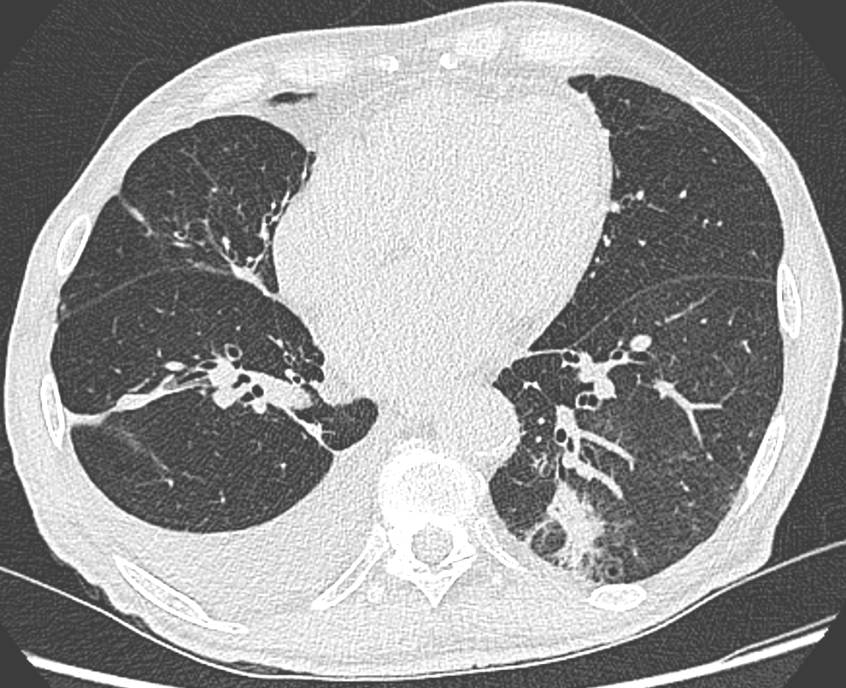
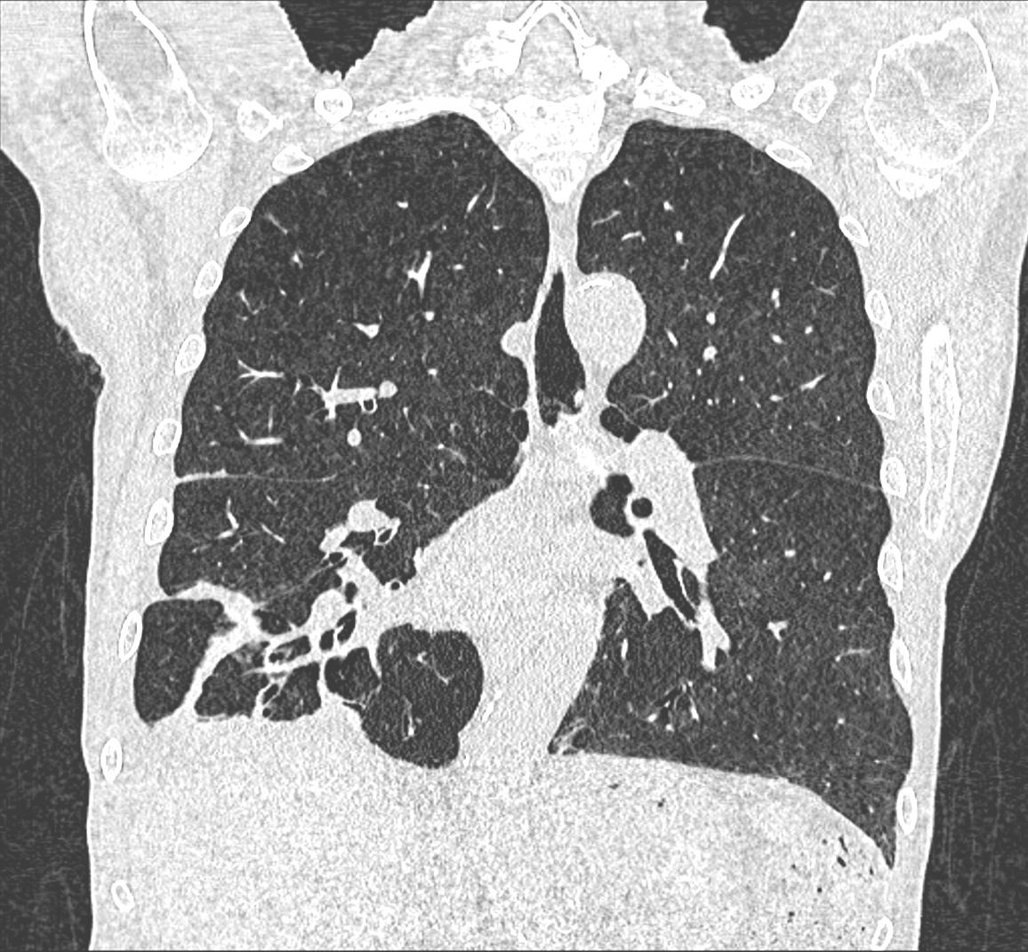
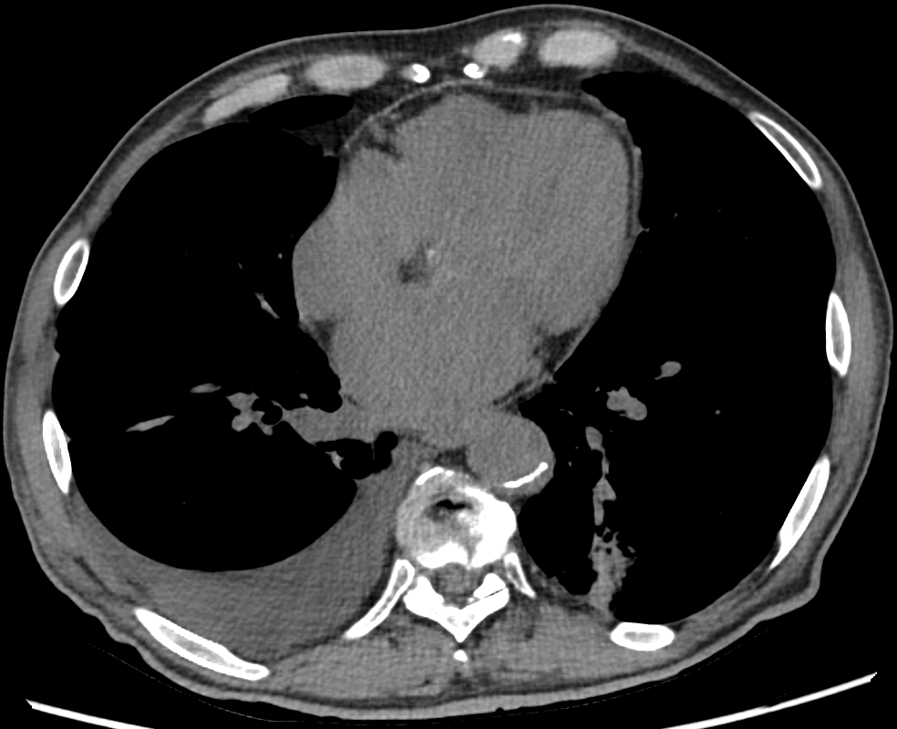
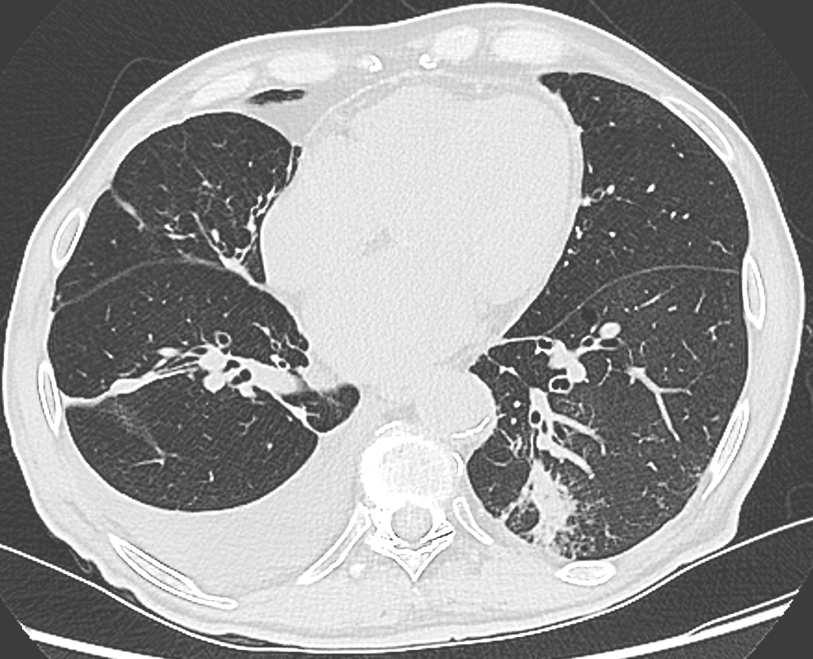
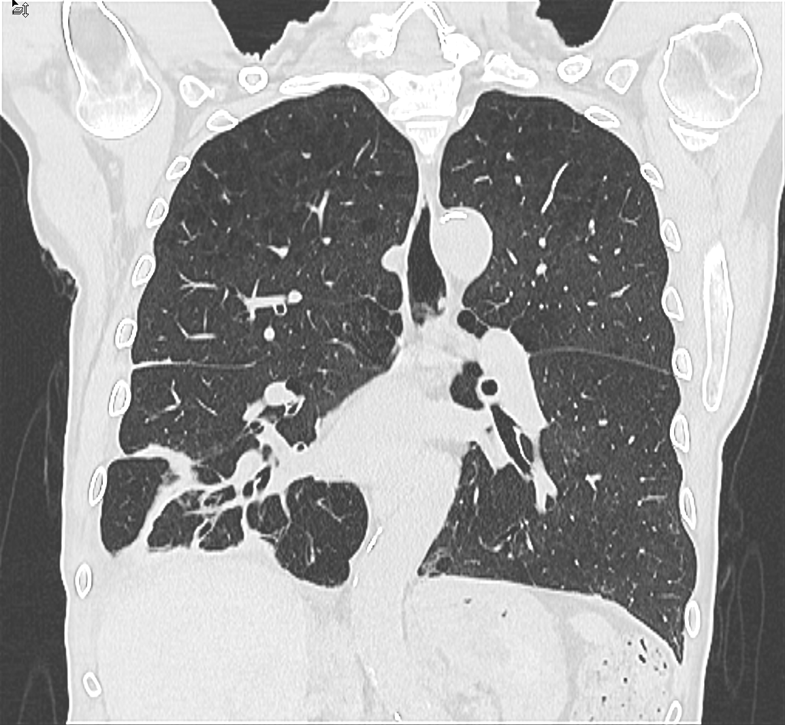
Low dose chest with TrueFidelity¹
DLP 86
Scan type | Helical 40mm
Rotation time, s | 0.35
Pitch | 1.531:1
Slice, mm | 1,25
Reconstruction | DL-H
Algorithm | Standard
kV | 120
mA | Mod.
Noise index
BPM | In case of cardiac exam
BMI | 22
CTDIvol, mGy | 2.7
DLP, mGy-cm | 86
ASIR-V
TrueFidelity
LU filter
LU filter
SAINT JOSEPH HOSPITAL – PARIS, DR. ZINS - FRANCE
1. Not commercially available for all regions
Notes:
FTR Gen3 Thorax TF Ctdi 2,7

Slide 6
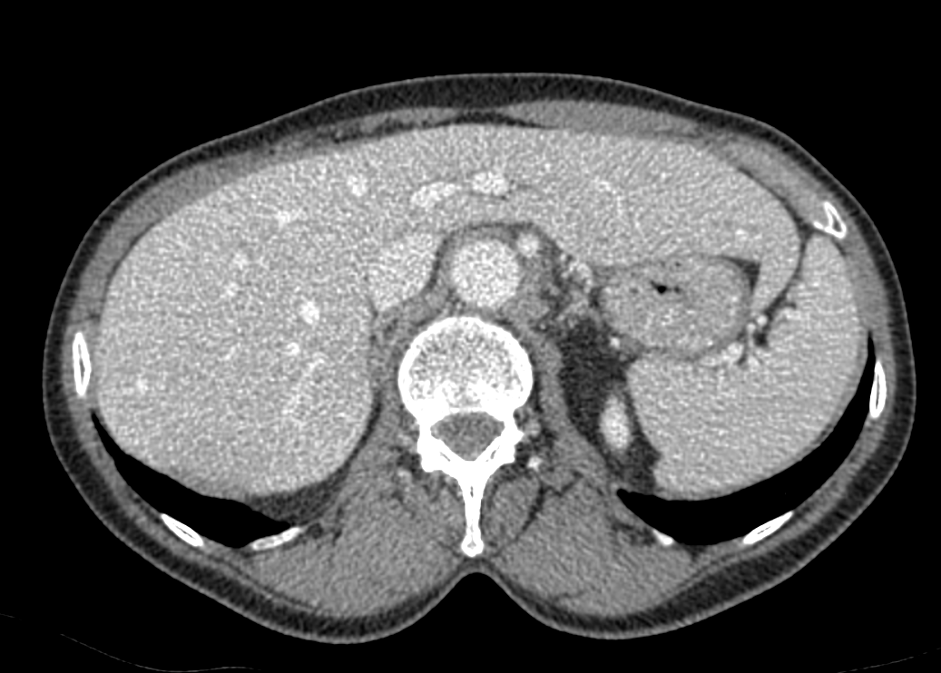
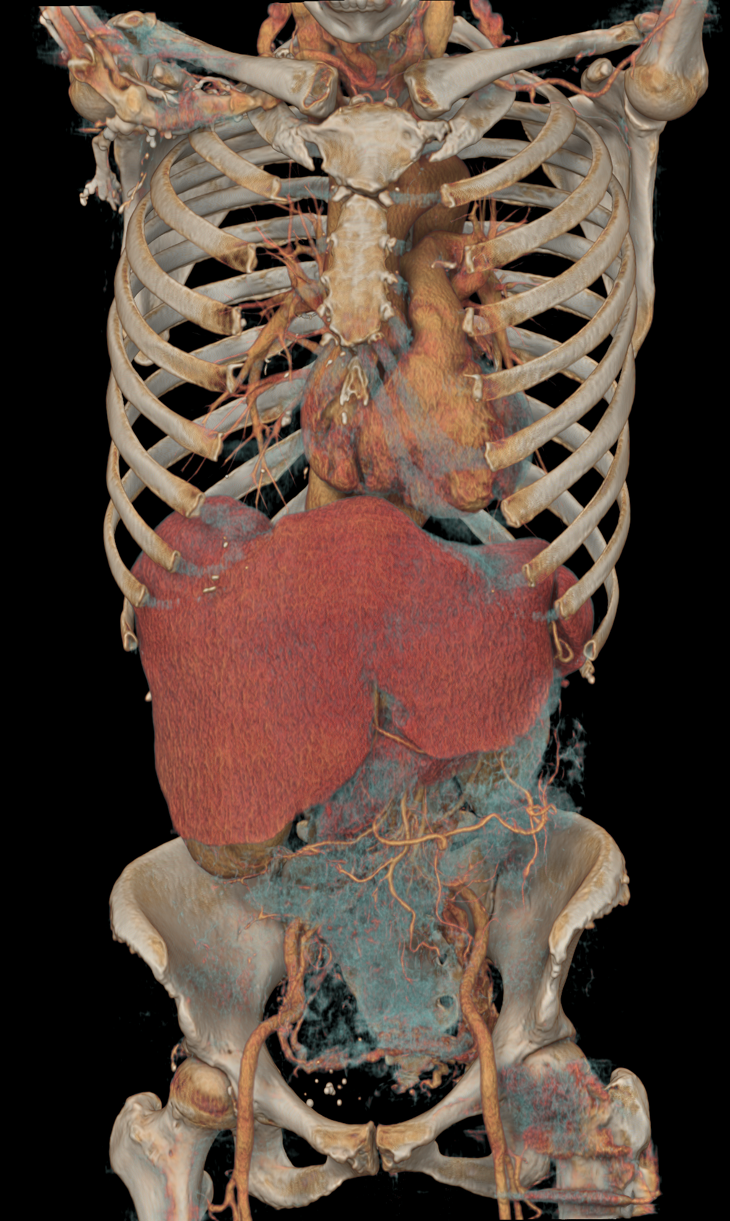
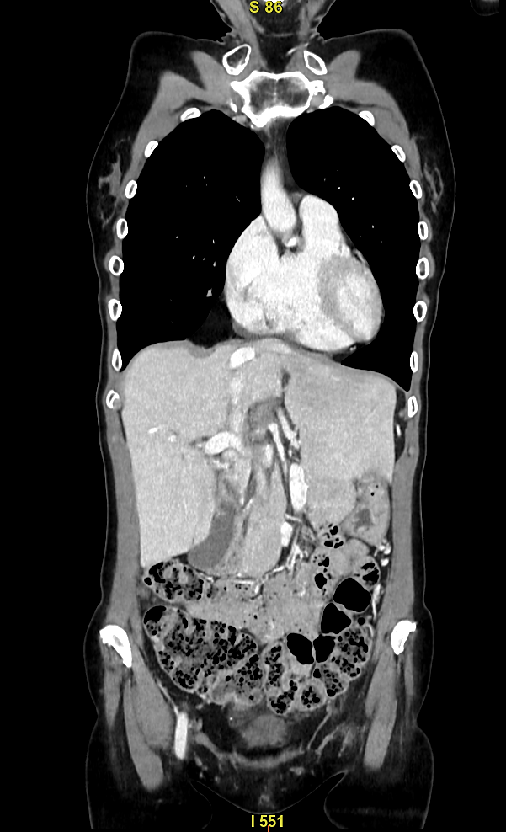
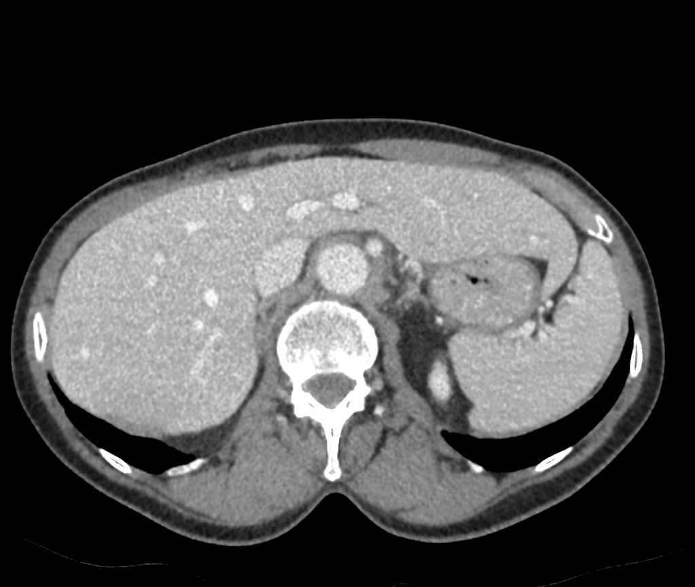
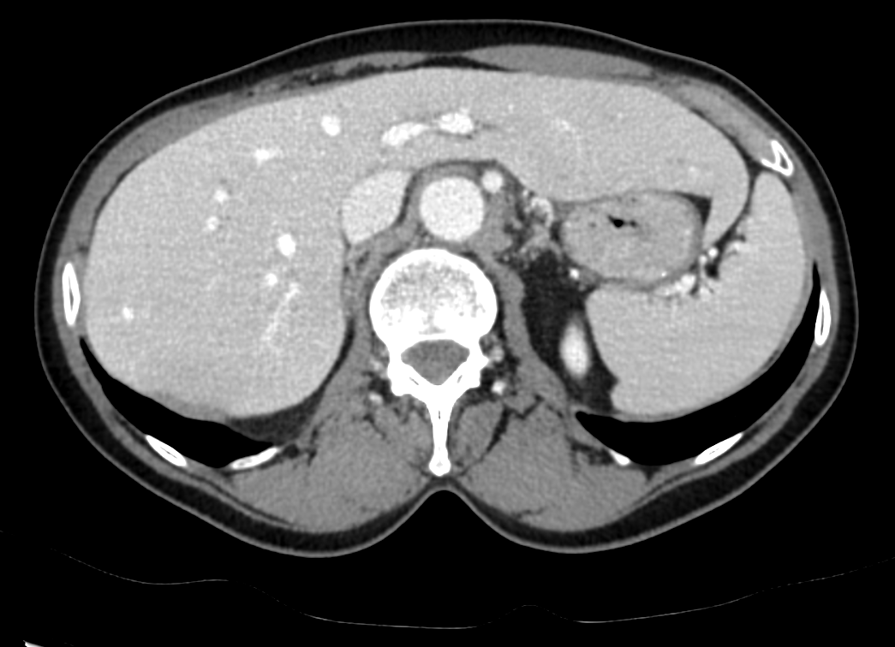
CAP with TrueFidelity¹
80kV - 298 DLP - 55cc contrast
Scan type | Helical
Rotation time, s | 0,5
Pitch | 0.984
Slice, mm | 0,625
Reconstruction | TF, AV50, FBP
Algorithm | Standard
kV | 80
mA | Mod
Noise index | 23
Contrast ml mgI/ml | 55 350
BMI
CTDIvol, mGy | 4.5
DLP, mGy-cm | 298
FBP
ASIR-V 50
Volume illumination TrueFidelity
TrueFidelity
TrueFidelity
of CIO (Groupe 3R), Onex, Switzerland.
1. Not commercially available for all regions
Notes:
FTR Gen3 CAP 80kV DLP 298 55cc comp FBP vs AR vs TF

Slide 7
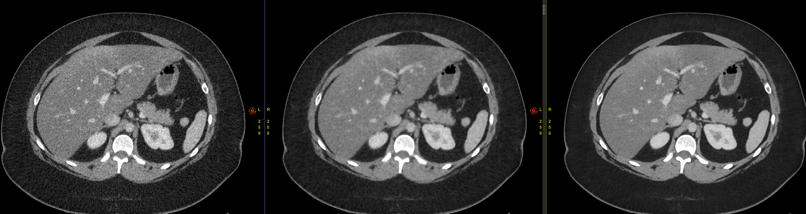
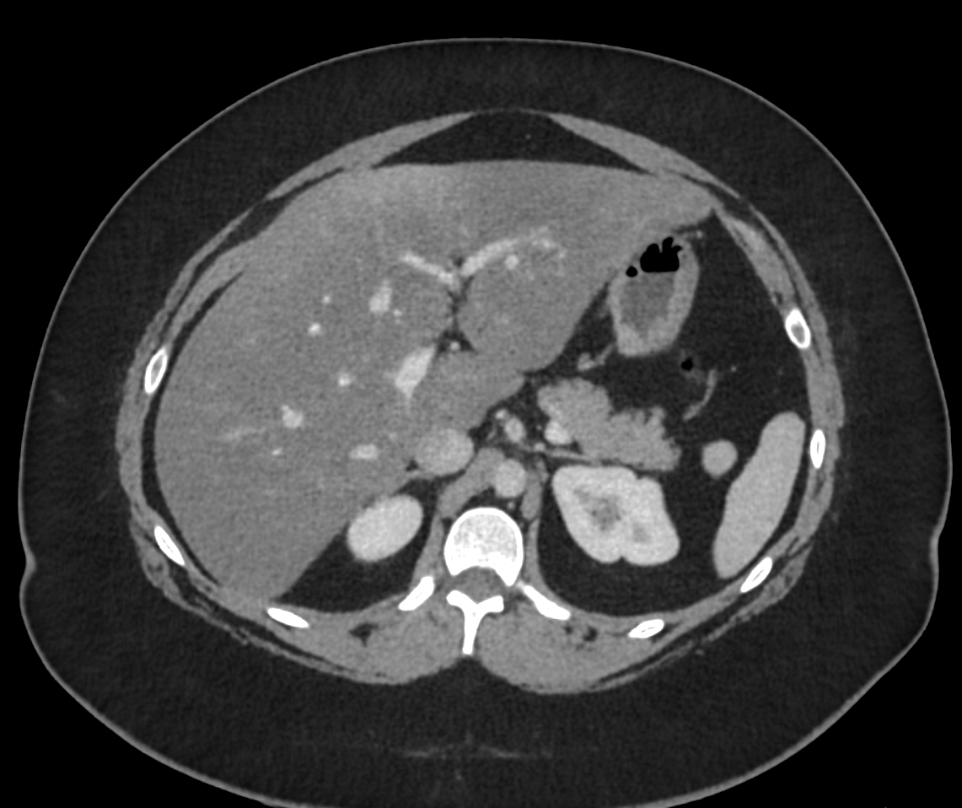
Abdomen for diffuse pain on a 46 BMI patient with TrueFidelity¹
Scan type | Helical
Rotation time, s | 0,35
Pitch | 0.516
Slice, mm | 0,625
Reconstruction | TF, AV50, FBP
Algorithm | Standard
kV | 120
mA | Mod
Noise index | 34
Contrast ml mgI/ml | 108 350
BMI | 46
CTDIvol, mGy | 17,9
DLP, mGy-cm | 896
History: | Abdominal pain
Findings: | No findings
TrueFidelity
FBP
ASIR-V 50
of CIO (Groupe 3R), Onex, Switzerland.
1. Not commercially available for all regions
Notes:
FTR Gen3 Abdomen BMI 46 ctdi 17 comp FBP vs AR vs TF

Slide 8
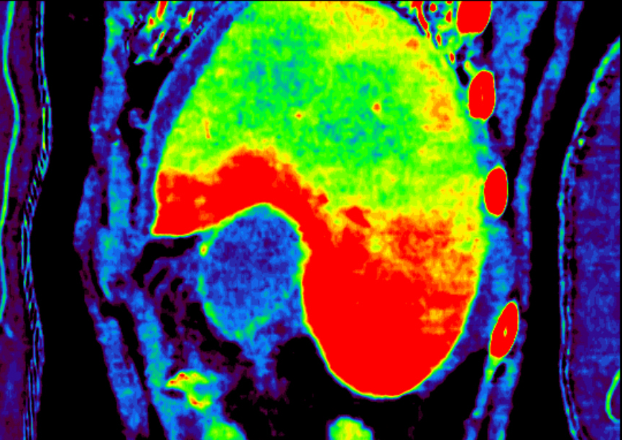
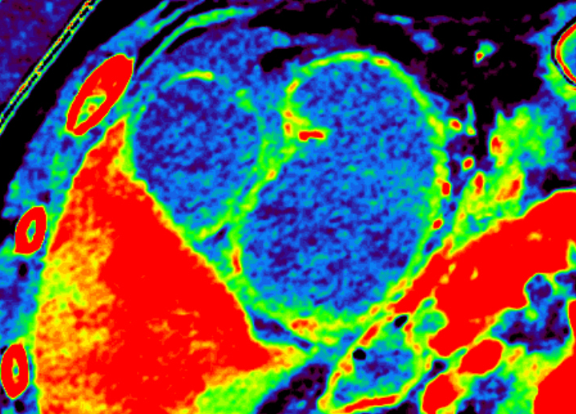
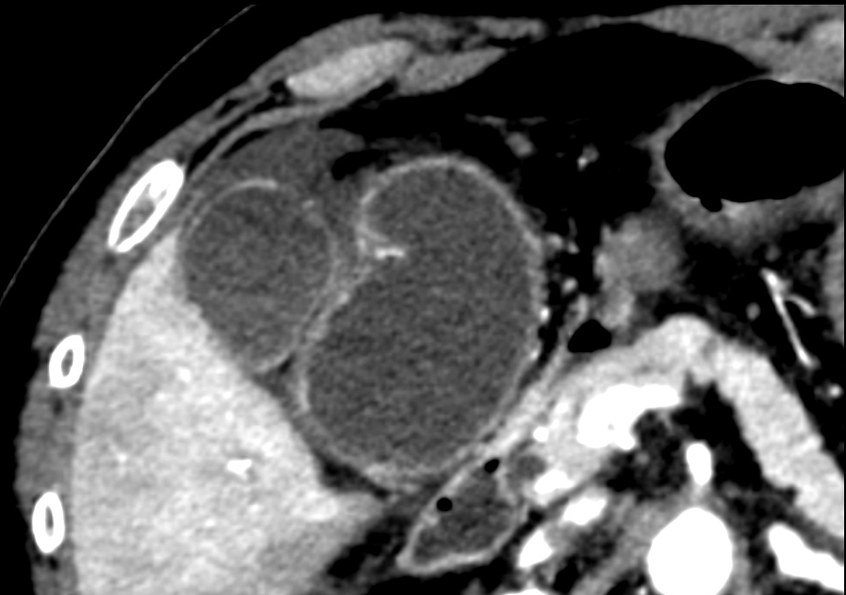
GSI Pro - AP - Gall bladder perforation
Scan type. | GSI 40mm helical
Rotation time, s | 0.6
Pitch | 0.984
Slice, mm | 1,25
Recon Algorithm | Standard
ASiR-V % | 30/60
CTDI vol, mGy DLP mGy x cm | 13 657
kV | ~
mA | 375
History: Abdominal pain, emesis. Scan purpose: Abdominal Emergency Finding: Gall bladder perforation. Hypoperfusion of the sigmoid loop wall. Dolichocolon. Liver hyperperfusion.
70KeV
MD Iodine/Water
MD Iodine/Water
65 KeV
SAINT JOSEPH HOSPITAL – PARIS, DR. ZINS - FRANCE

Slide 9
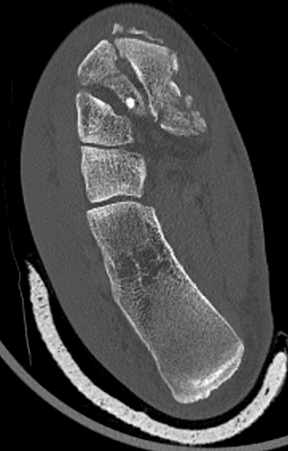
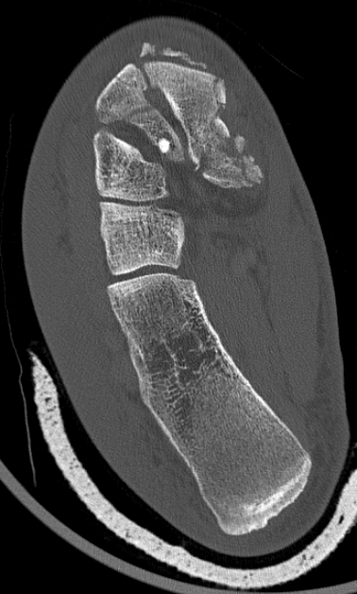
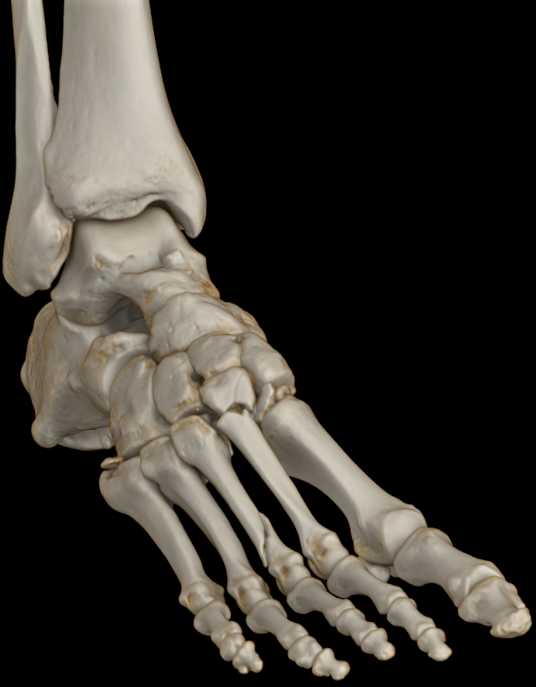
HD - Foot post trauma –1024 matrix
Shattered fractures
Scan type | Helical 20 mm
Rotation time, s | 0.8
Pitch | 0.531:1
Slice, mm | 0,625
Reconstruction | ASiR- V
Algorithm | HD Bone +
kV | 100
mA | 140
CTDIvol, mGy | 11
DLP, mGy-cm | 260
512
1024
Volume illumination
SAINT JOSEPH HOSPITAL – PARIS, DR. ZINS - FRANCE
Notes:
FTR Gen3 Ankle Foot Trauma ctdi 11 1024

Slide 10
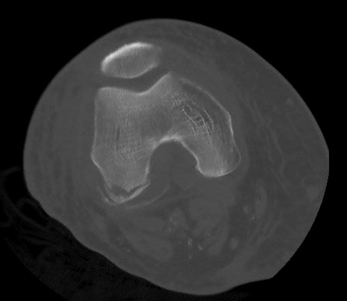
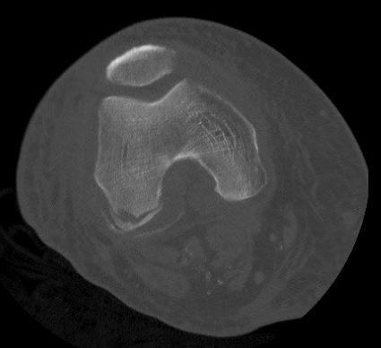
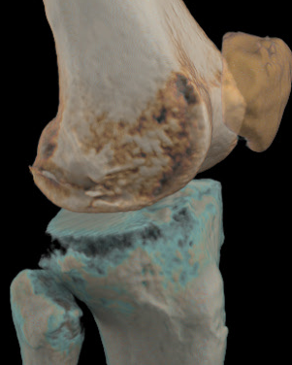
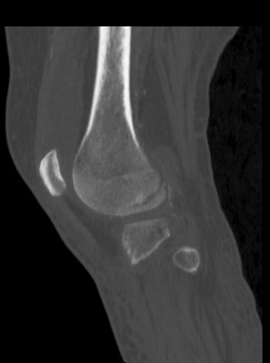
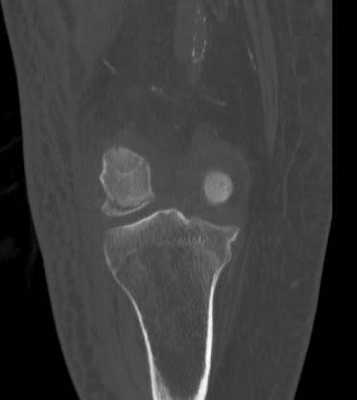
Trauma – Knee – Hi Resolution + 1024 Matrix
Scan type | Helical
Rotation time, s | 0.6
Pitch | 0.516
Slice, mm | 0.625
Reconstruction | ASiR-V 60%
kV | 80
mA | 245 - 335
Noise index | 28.5
Algorithm | HD Standard & HD Bone
CTDi | 11.27
History: Findings: | Trauma to knee Fracture of Condyle
Axial 512 Axial 1024
Volume Illumination segmented and combined volumes
Sagittal 1mm
Coronal 1mm
OF N. TESSIER WATFORD GENERAL HOSPITAL - UK

Slide 11
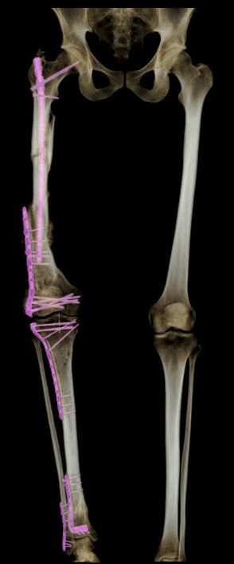
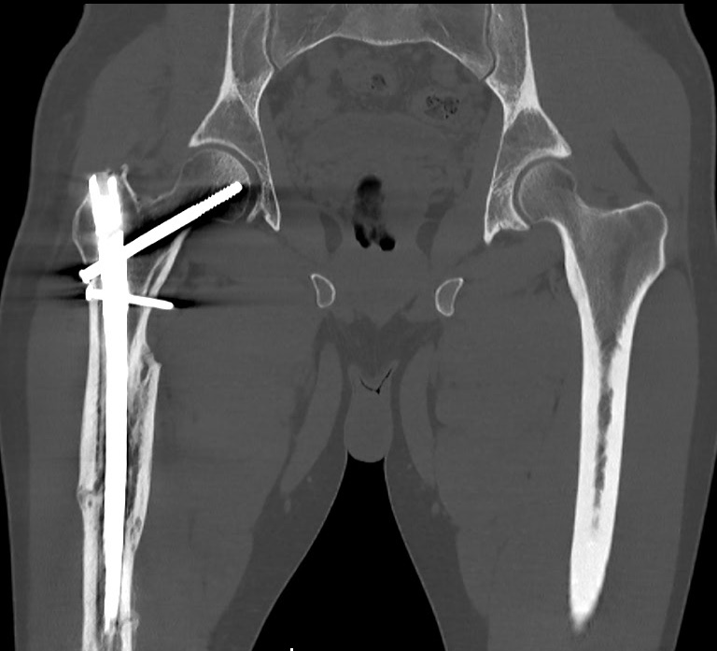
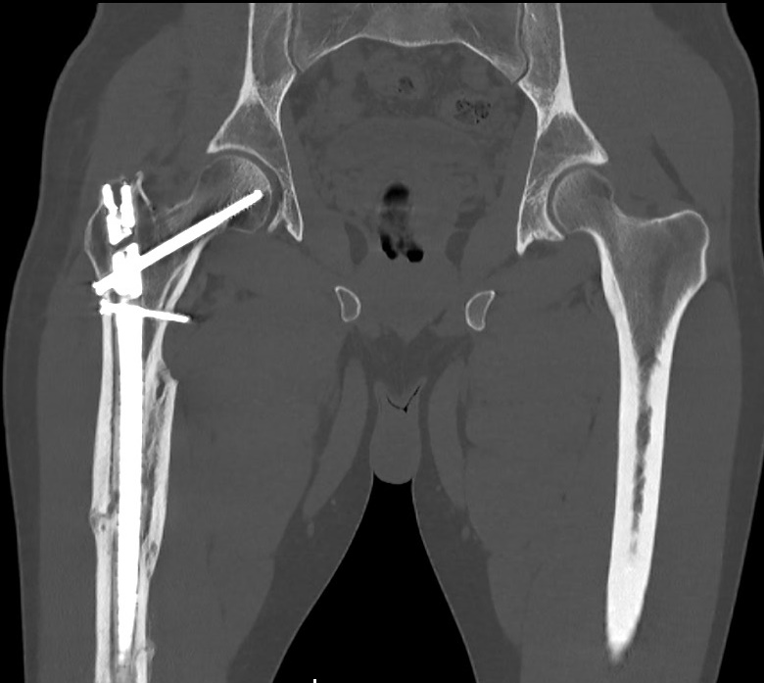
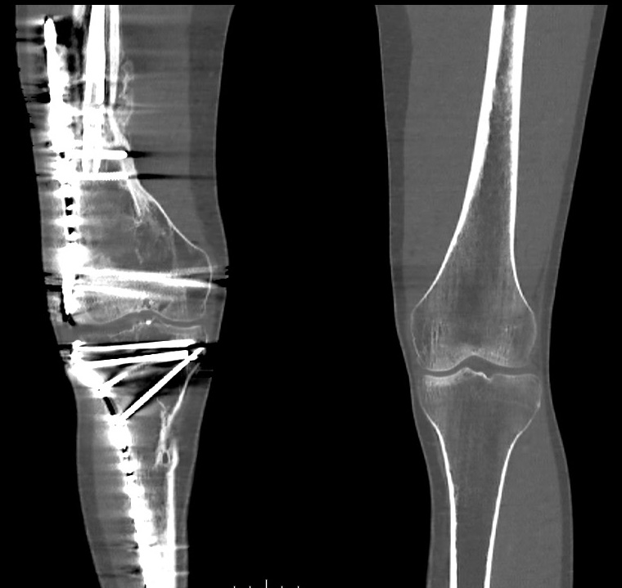
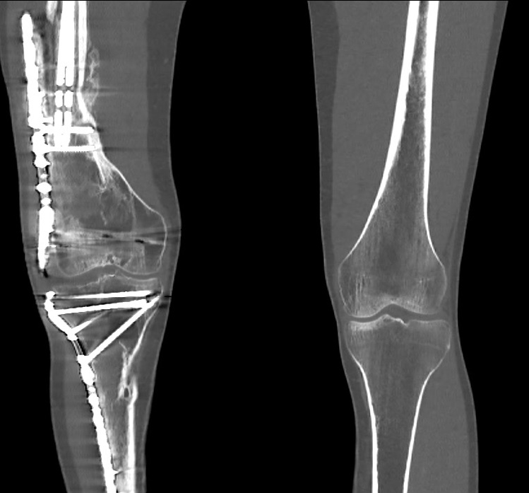
Hip – Femur – Knee – Ankle Smart MAR
Scan type | Helical 40 mm
Rotation time, s | 0.8
Pitch | 0.984
Slice, mm | 0.625
Reconstruction | ASiR-V 50%
kV | 120
mA | 60 – 421 mA modulation
Noise index | 22.7
Algorithm | Standard & Bone Plus
History: | ? Follow up post surgery Road Traffic Accident
c
Volume
Illumination
Coronal 0.625mm
without Smart MAR
Coronal 0.625mm with
Smart MAR
OF N. TESSIER WATFORD GENERAL HOSPITAL - UK

